Slide 1

CAPSTONE PROJECT-3
Mobile Price Range Prediction
SATYAM JYOTI SANKAR

Slide 2
CONTENT
1) Defining problem statement 2) E D A and feature engineering
Feature Selection
Preparing dataset for modeling
Applying Model
Model Validation and Selection
Conclusion

Slide 3
Problem Statement
The problem statement is to predict the price range of mobile phones based on the features available (price range indicating how high the price is). Here is the description of target classes:
0 - Low cost Phones
1 - Medium cost phones
2 - High cost phones
3 - Very High cost phones
This will basically help companies to estimate price of mobiles to give tough competition to other mobile manufacturer. Also, it will be useful for consumers to verify that they are paying best price for a mobile.

Slide 4
DATA SUMMARY
Independent variables :
Independent variables :
Battery_ power - Total energy a battery can store in one time
measured in mAh
B l u e - Has bluetooth or not
C lock_ speed - speed at which microprocessor executes
instructions
Dual_ s im - Has dual sim support or not
Fc - Front Camera mega pixels
Four_ g - Has 4G or not
Int_ memory - Internal Memory in Gigabytes
M_ dep - Mobile Depth in cm

Slide 5
DATA SUMMARY(cont..)
Mobile_ wt - Weight of mobile phone
N_ cores - Number of cores of processor
Pc - Primary Camera mega pixels
Px_ heig ht - Pixel Resolution Height
Px_ width - Pixel Resolution Width
R a m - Random Access Memory in Mega Bytes
Sc_ h - Screen Height of mobile in cm
Sc_ w - Screen Width of mobile in cm
Talk_ t ime - longest time that a single battery charge will last when you are

Slide 6
DATA SUMMARY(cont..)
Three_ g - Has 3G or not
Touch_ screen - Has touch screen or not
Wifi - Has wifi or not
D e p e n d e nt variables :
Price_ range - This is the target variable with value of
0(low cost), 1(medium cost), 2(high cost)
and 3(very high cost).

Slide 7
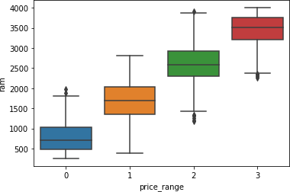
EDA(contd...)
Relation Between Price Range & Ram
This is a positive relationship, with increase in RAM, price too increases. There are
4 types of price range
Type 1(low cost): RAM ranges between 216 to 1974 megabytes.
Type 2(medium cost): RAM ranges between 387 to 2811 megabytes
Type 3(high cost): RAM ranges between 1185 to 3916 megabytes
Type 4(very high cost): RAM ranges between 2255 to 4000 megabytes

Slide 8
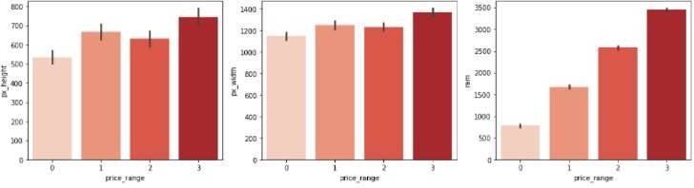
Relationship between the Price Range and Pixel Height/ Width /Ram
Here we see that Ram of phone and price are highly corelated increase in ram increase in
price
From the above bar plot, we can see that the average pixel height and width are highest for
the price range 3(very high cost).
Low-cost phones have smaller average pixel width and pixel height.
We can observe from this Bar plot that pixel height and pixel width are roughly equal in relevance when it comes to model development for prediction.

Slide 9
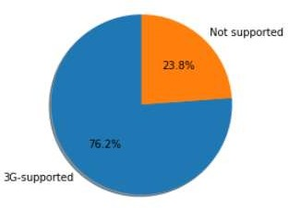
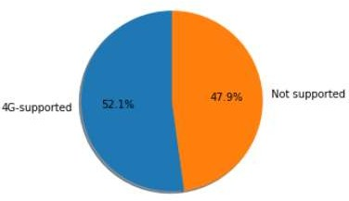
EDA(contd...)
3G-4G supported and Non-supported.
From the above fig, we can see that 3G-supported is 76.2%
and 4G-supported is 52.1%.

Slide 10
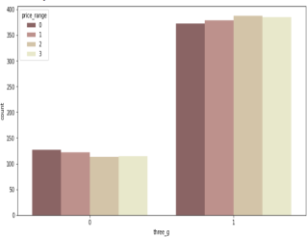
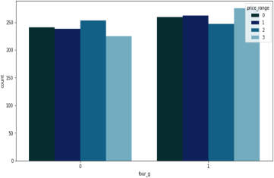
EDA(contd...)
Relation between Price Range & 3G/4G.
Here , we see the price range also affecting the 3G and 4G .

Slide 11
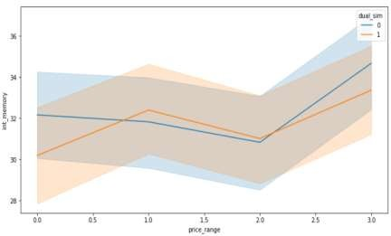
Multivariate analysis - int_memory, mobile_wt
There is drastic increase in internal memory for vey high prices.
Also there is drastic Decrease in mobile weight for very high price

Slide 12
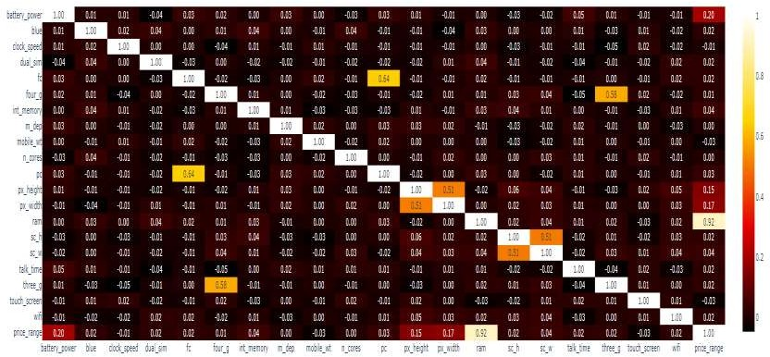
MULTIVATIATE ANALYSIS
From the above correlation graph
three_g and four_g are moderately correlated.
px_width and px_height are moderately correlated. We will try to change them into a single
variable.
ram is highly correlated with our price range. May be one the most important factor in
determining the price.

Slide 13

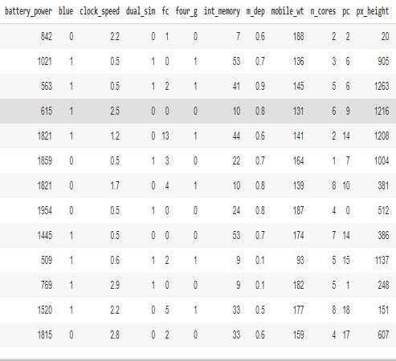
P re p a r in g dataset for m o d e l i n g
Ta s k : multiclass
classification
Train set : (1340 , 17)
Test set : ( 660 , 17) Re s p o n s e : 0 - 1-2-3

Slide 14
MODEL BUILDING
KNEIGHBOUR CLASSIFIER
RANDOM FOREST CLASSIFIER
GRADIENT BOOSTING CLASSIFIER
LOGISTIC REGRESSION
XGB CLASSIFIERD
DECISION TREE CLASSIFIER
SUPPORT VECTOR MACHINE

Slide 15
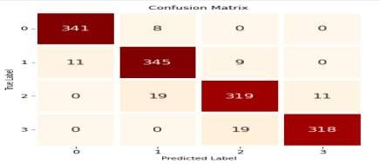
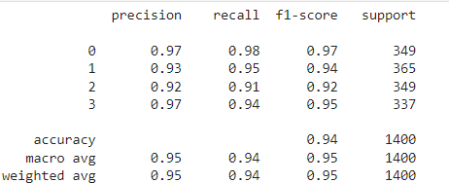
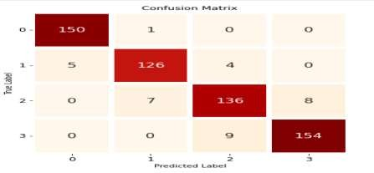
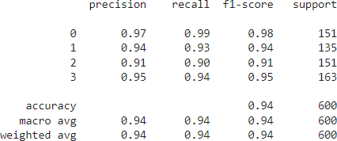
I m p l e m e nt i n g K N e i g h b o u r s Classifier contd.
Train metr ics
Test metrics

Slide 16
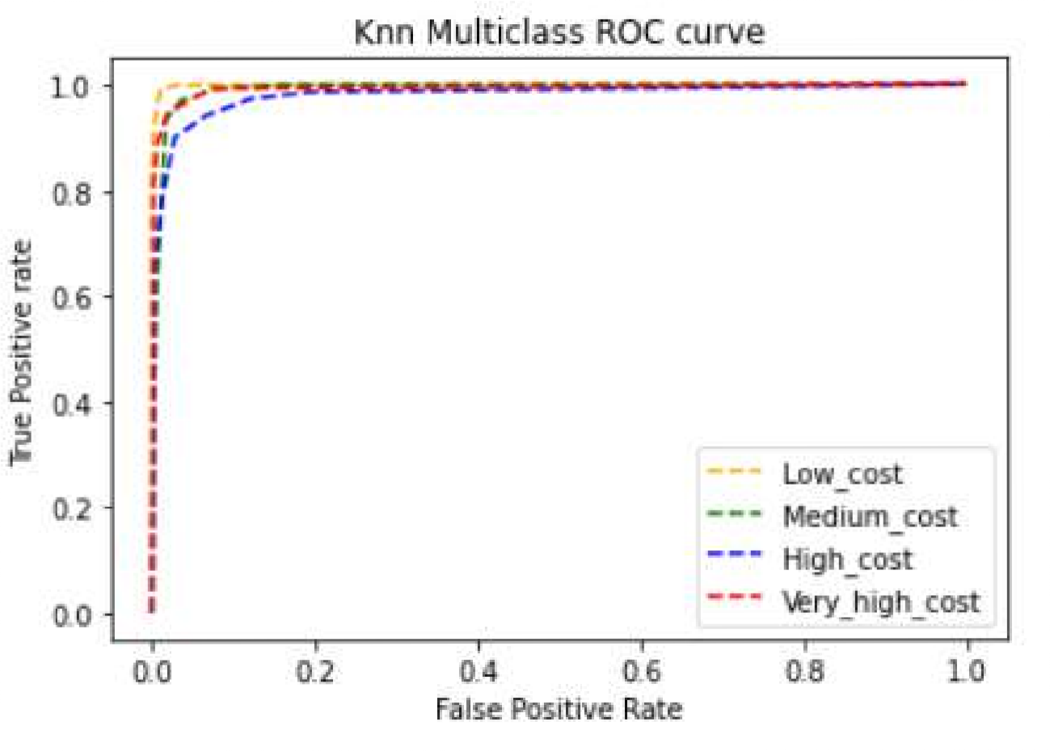
I m p l e m e nt i n g K N e i g h b o u r s Classifier
T P R = TP/( TP+ FN)
F P R = FP/( FP+ TN)

Slide 17
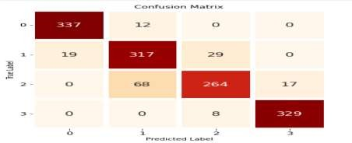
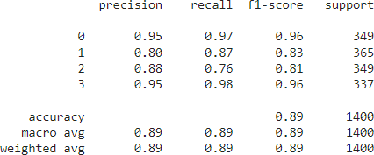
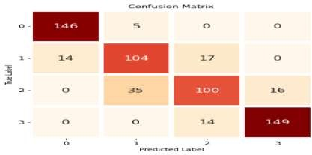
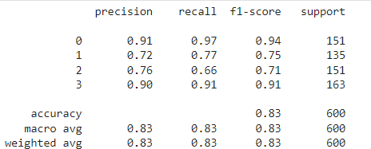
I m p l e m e nt i n g R a n d o m Forest Classifier
Train metr ics
Test metrics

Slide 18
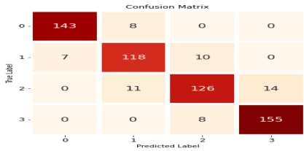
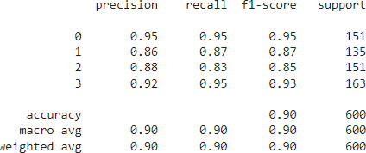
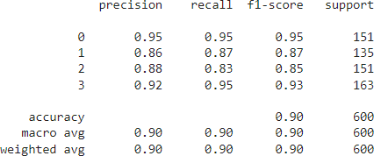
I m p l e m e nt i n g Gradient Boosting Classifier
Train metr ics
Test metrics

Slide 19
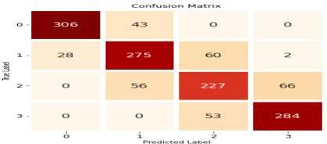
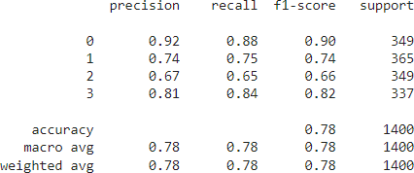
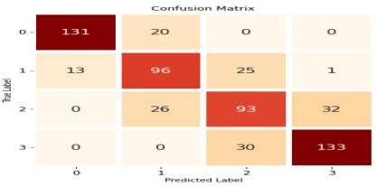
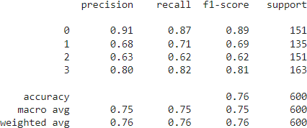
I m p l e m e nt i n g Lo g i s t i c regression
Train metr ics
Test metrics

Slide 20
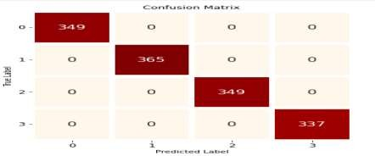
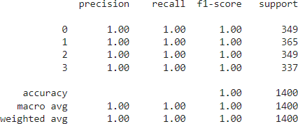
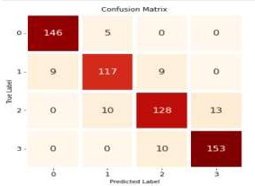
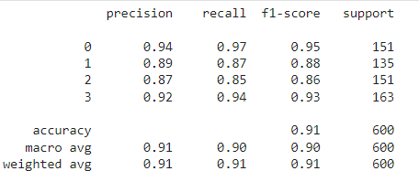
I m p l e m e nt i n g XGBClassifier
Train metr ics
Test metrics

Slide 21

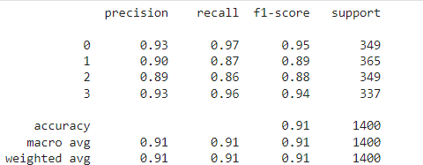
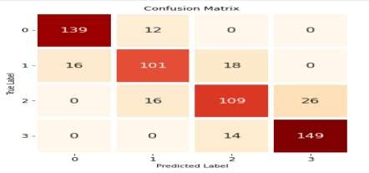
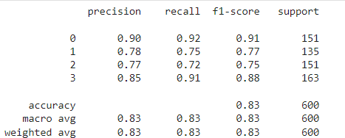
I m p l e m e nt i n g Decision Tree Classifier
Train metr ics
Test metrics

Slide 22
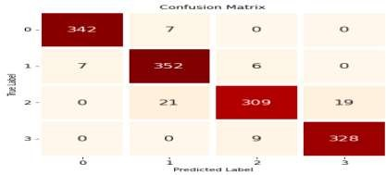
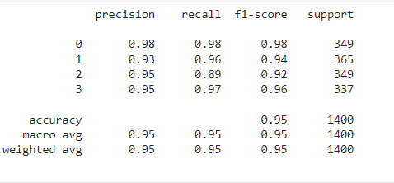

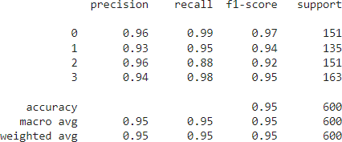
I m p l e m e nt i n g Support Vector Machine
Train metr ics
Test metrics

Slide 23
Best Hyperparameters
So we had chosen Kneighbors classifier for the prediction and the best
hyperparameters obtained are as below
Best hyperparameters :
Train : (algorithm='auto',
leaf_size=30,
metric=‘Euclidean',
metric_params=None, weights='distance’)
n_jobs=None,
n_neighbors=11, p=2,
Test : (algorithm='auto', leaf_size=30, metric='euclidean', metric_params=None, n_jobs=None, n_neighbors=17, p=2, weights='distance')

Slide 24
CONCLUSION
Ram , Battery_power features were found to be the most relevant features for predicting price range of mobiles and dropping negative correlation features which are clock speed , mobile_wt , touch_screen
Knn gives acc score of 95% and Xg boost 91%.
Xgboost and KNN both are given best roc_auc_accuracy score of 99%.
In case of Xgboost hyper parameter(using grid_search cv ) gives very good result.
Logistic regression is giving the less results among all the algorithms
So we conclude that kneighbors classifier and Xgboost is giving the best results for these dataset
So we can say that in the price range prediction as the ram and
battery_power increases the price range will increase for sure .

Slide 25
THANK YOU

